Slide 1
Bank Marketing
Andarisa Rachmadian Akbar
JCDS08

Slide 2
Data Introduction
Direct marketing campaigns of a Portuguese banking institution.
The marketing campaigns were based on phone calls.
Source : https://archive.ics.uci.edu/ml/datasets/Bank+Marketing
Goals : Predict if the product (bank term deposit) would be (or not) subscribed. (Classification).

Slide 3
Features
•Age
•Job
•Marital Status
•Education
•Default
•Balance
•Housing
•Loan
•Contact
•Day
•Month
•Duration
•Campaign
•Pdays
•Previous
•Poutcome
Features Total : 16

Slide 4
Process
Store
Store Input Data into mysql.
Machine Learning Modelling.
Using Logistic Regression, Decision Tree Classifier, and Random Forest Model.
EDA
Deploy
Gathering insight from dataset.
Deplot best model to flask app.
Clean & Preprocess Data
Evaluating.
- Removing unknown value in dataset.
- Grouping dataset
Compare the score of each model and choose model that has a highest performance → Random Forest

Slide 5
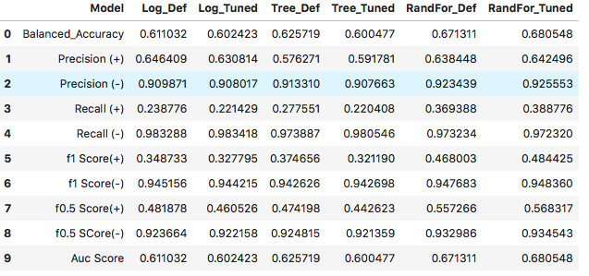
Conclusion
Predicted on ytest
 | 90.61%
 | Comparing ytest actual to ytest predicted and got 90.61% accuracy.

Slide 6
Next Improvement
01
02
Handle Unbalanced Data
One Hot Encoding
Using Over Estimate etc.
Apply one hot encoding to the input features.
03
04
Feature Selection
Using Another Model
Choosing the first 95% cumulative features before training the dataset.
Using another classification technique.

Slide 7
Thank you

